Slide 1
Algorithmic Trading
An Basic Exploration Using Python and Simplified Strategies
Notes:
Chris:
Hi we are Chris, Louis, Today we will talk about our Algorithmic Trading project including a brief history of trading, our process (including why we chose the stock we did), and walk you through some of our code and visuals. Our goal was to create a predictive stock trading tool that accumulated that best results.

Slide 2
History of Trading -
Why do people trade?
First use of algorithm for trading
Barriers to entry have never been lower
Notes:
Lou:
Why do people trade answer? Trade increases competition and lowers world prices, which provides benefits to consumers by raising the purchasing power of their own income, and leads a rise in consumer surplus. Trade also breaks down domestic monopolies, which face competition from more efficient foreign firms.
1st use of algorithmic trading: The beginning of computational finance dates back to 1930s when some investors started calculating mathematics formulas to price stocks and bonds. In 1950s Harry Markowitz introduced computational finance in order to solve the portfolio selection problem.

Slide 3
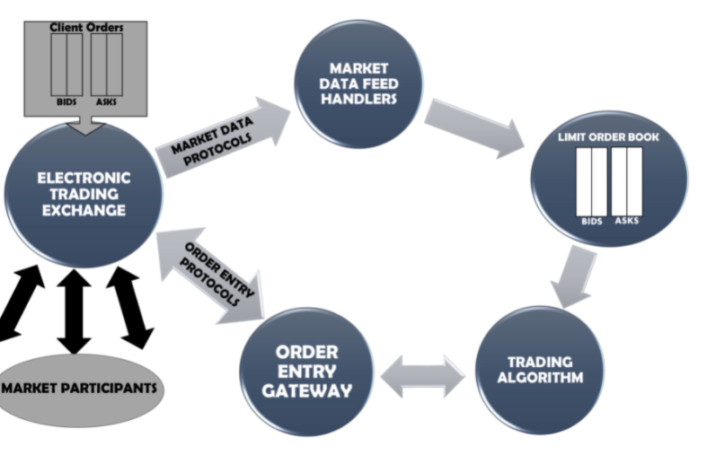
Trading Flow
Notes:
Lou

Slide 4
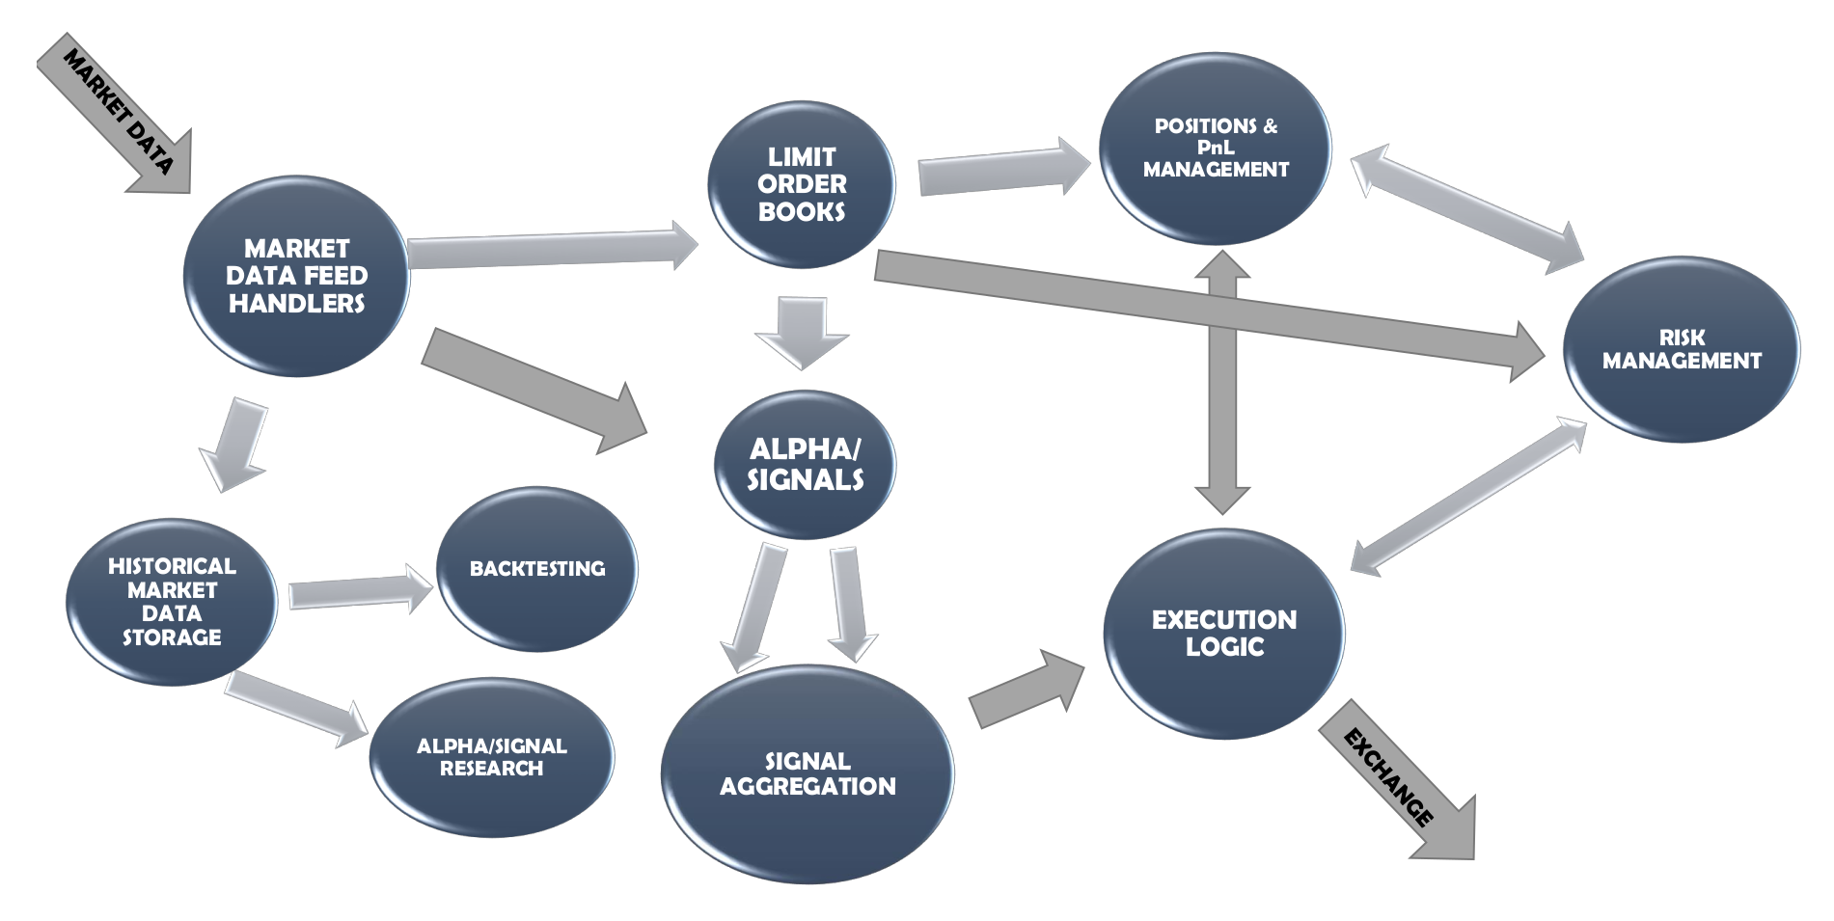
Components of Algo Trading System
Notes:
Lou

Slide 5
Key Components of an Algo Strategy
Data sourcing - market data (OHLCV), alt data, accounting data
Signal generation from that data
Backtesting - how does it perform on paper?
Universe selection (what do we want trade?)
Adjust for market conditions / risk, etc.

Slide 6
Our Process
We brainstormed many different algorithmic trading strategies when going through this process.
Initial Basic Trading Strategy
Random Forest
Monte Carlo
Linear Regression
Notes:
Initial Trading Strategy-The trading strategy we used was based on 1 day before and to buy or sell based on that.
Random forest strategy- was a bit too simple of a strategy.
Monte Carlo Simulation- Felt the results were most accurate in a predictive model.

Slide 7
Trading Strategy
Simple Moving Average
Turtle Trading Strategy
Notes:
Simple moving average strategy seemed to make more sense because we got more authentic (accurate but also based on a more complex trading strategy). Simple Moving Averages smooth the price trends and remove noise from the series. When asset prices move over their SMA (cross-over), it may indicate a trading signal. Using a shorter term MA with a longer term MA is known as a "golden cross". Investors watch for shorter term to cross above the longer term for their buy signal. When the shorter term crosses under the longer term, it's a sell signal.
Bollinger Bands are envelopes plotted at a standard deviation level above and below a simple moving average of the price. Because the distance of the bands is based on standard deviation, they adjust to volatility swings in the underlying price. Bollinger Bands use 2 parameters, Period and Standard Deviations, StdDev.
Turtle Trading strategy-The core of the turtle trading strategy is to take a position on futures on a 55-day breakout. A 55-day breakout is when the price exceeds high or low of past 55 days price.
Model Summary
Elaborate on the predictive model used, describing why it was the best choice for the data.
Data Cleanup & Model Training
Describe the exploration and cleanup process.
Discuss any problems that arose with preparing the data or training the model that you didn't anticipate.
Discuss the overall training process and highlight anything of interest with the training process: Cloud resources used, training time required, issues with training.
Model Evaluation
Discuss the techniques you used to evaluate the model performance.
Discussion
Discuss your findings. Was the model sufficient for the predictive task? If not, why not? What inferences or general conclusions can you draw from your model performance?
Questions
Open-floor Q&A with the audience.

Slide 8
Walking Through our Code
Now we will walk through our final code. We will cover:
Model Summary
Data Cleanup
Model Evaluation

Slide 9
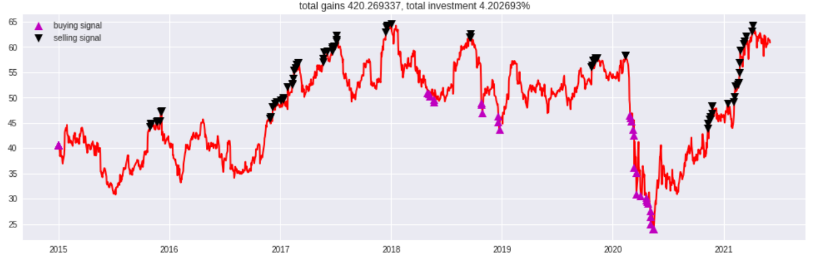
Graphic-Turtle Strategy

Slide 10
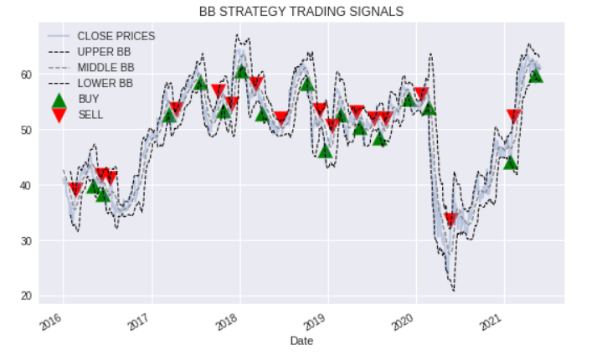
Graphic-BB Strategy Trading

Slide 11
Q&A
Thank you for your time!

